Slide 1

VIBGYOR
SAY HI TO PLASTIC
MANOHAR KODURI
29-05-2019

Slide 2
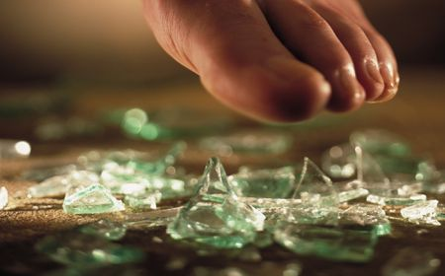
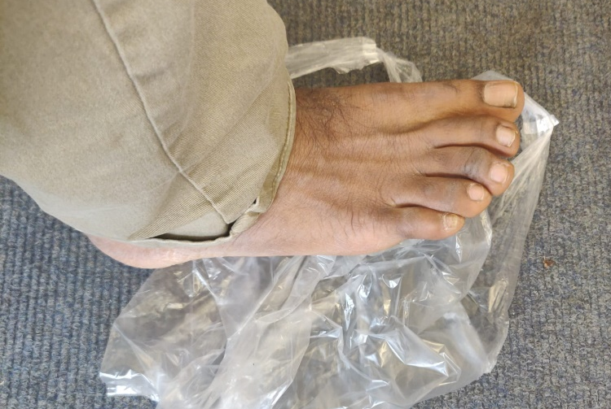
Which one is painful?
Foot on broken Glass
VIBGYOR
Foot on Plastic bag

Slide 3
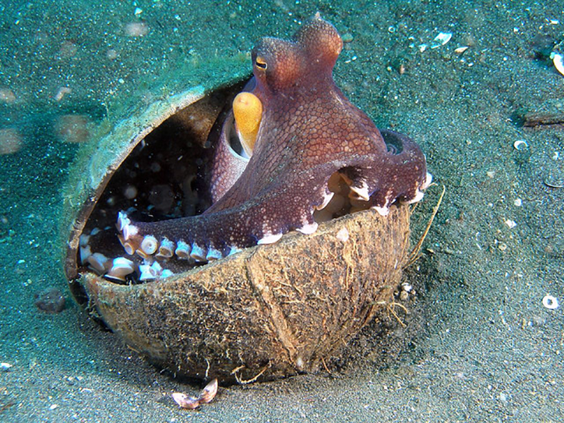
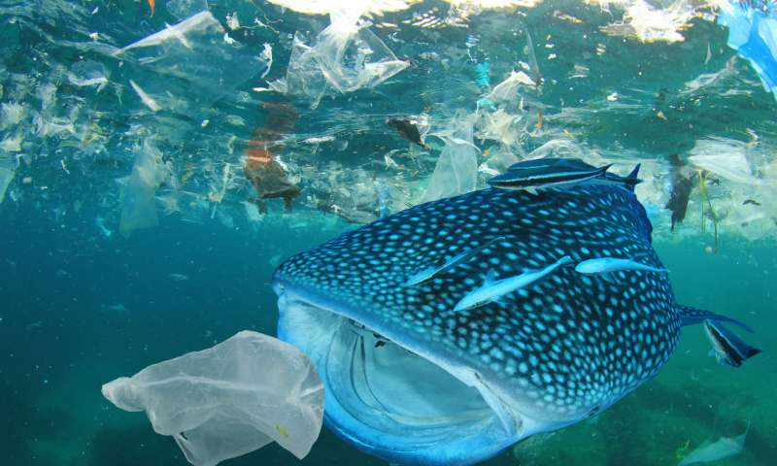
Do all waste generated by Humans can be used by other creatures?
Attempt to make use of plastic !!!
Octopus make use of coconut shell !!!
VIBGYOR

Slide 4
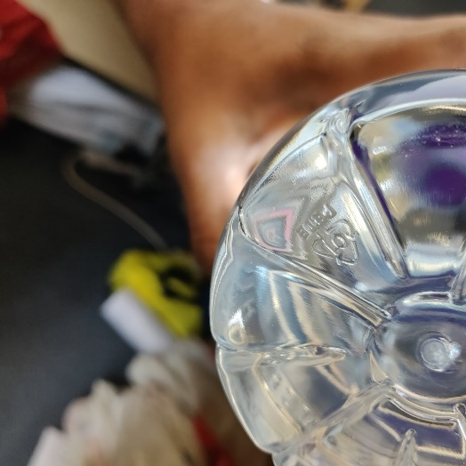
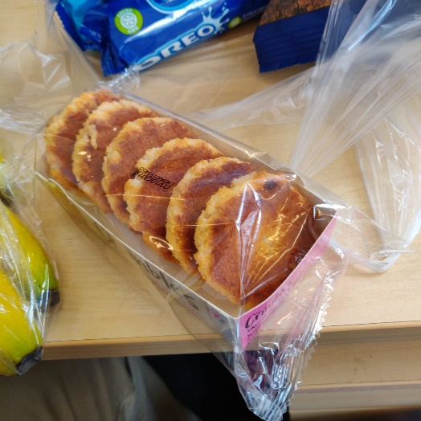
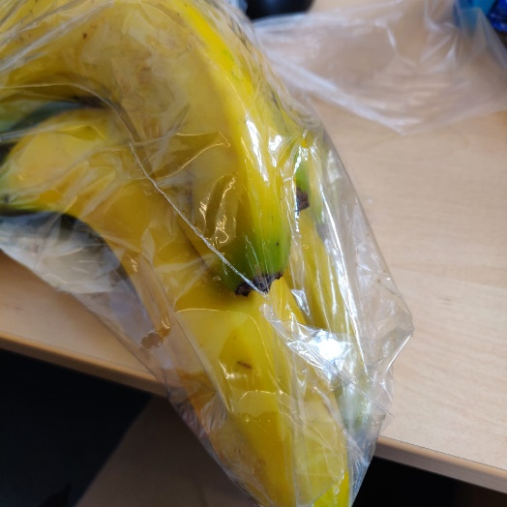
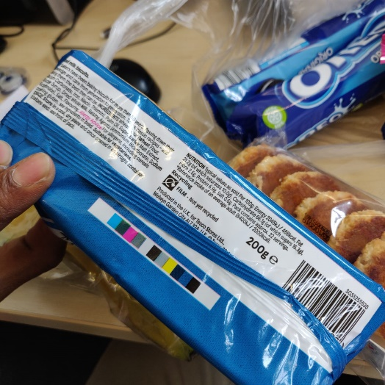
Are we as Humans aware of types of plastic ?
Category 1
Category ?
Category ??
Category ???
VIBGYOR

Slide 5
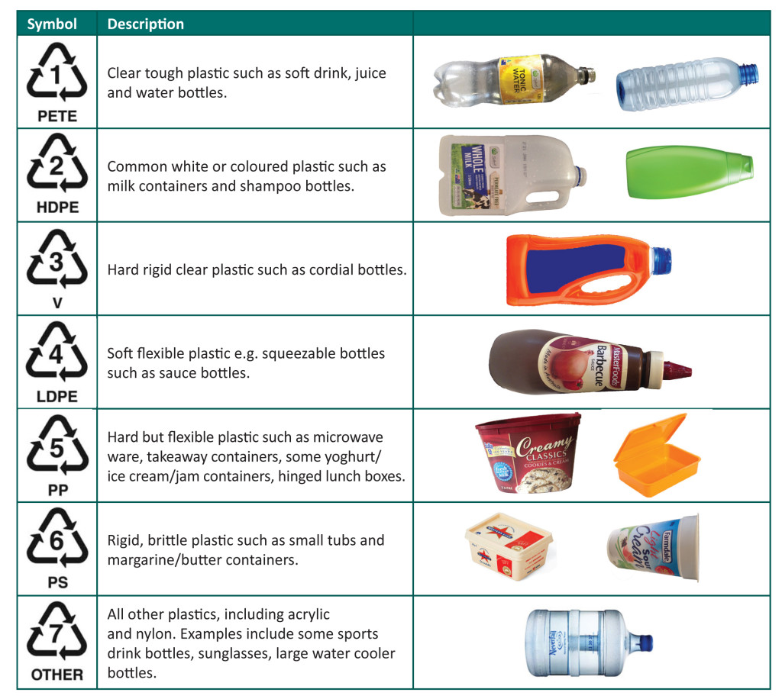
Types of Plastic

Slide 6
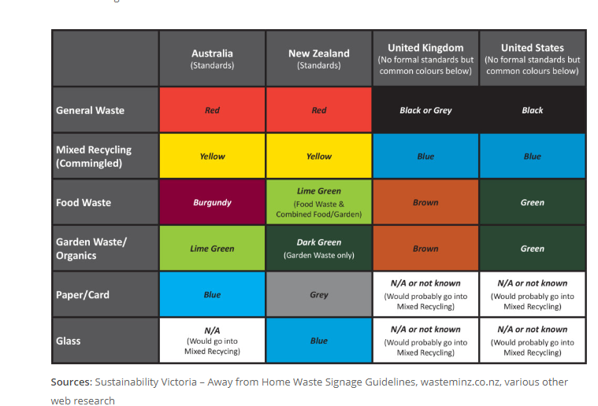

Slide 7
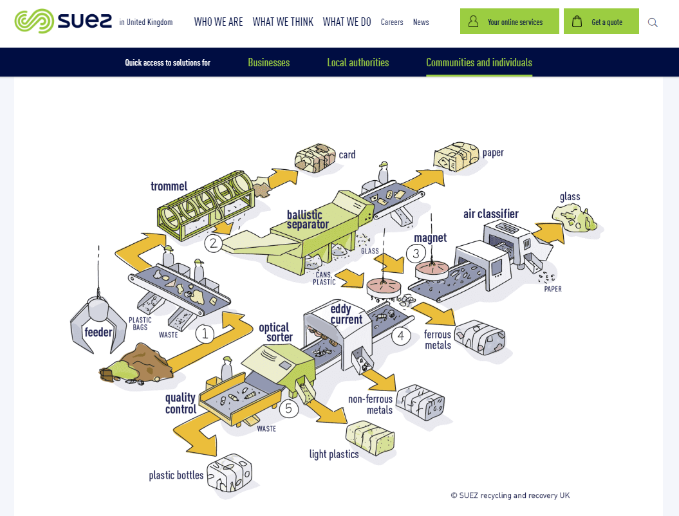
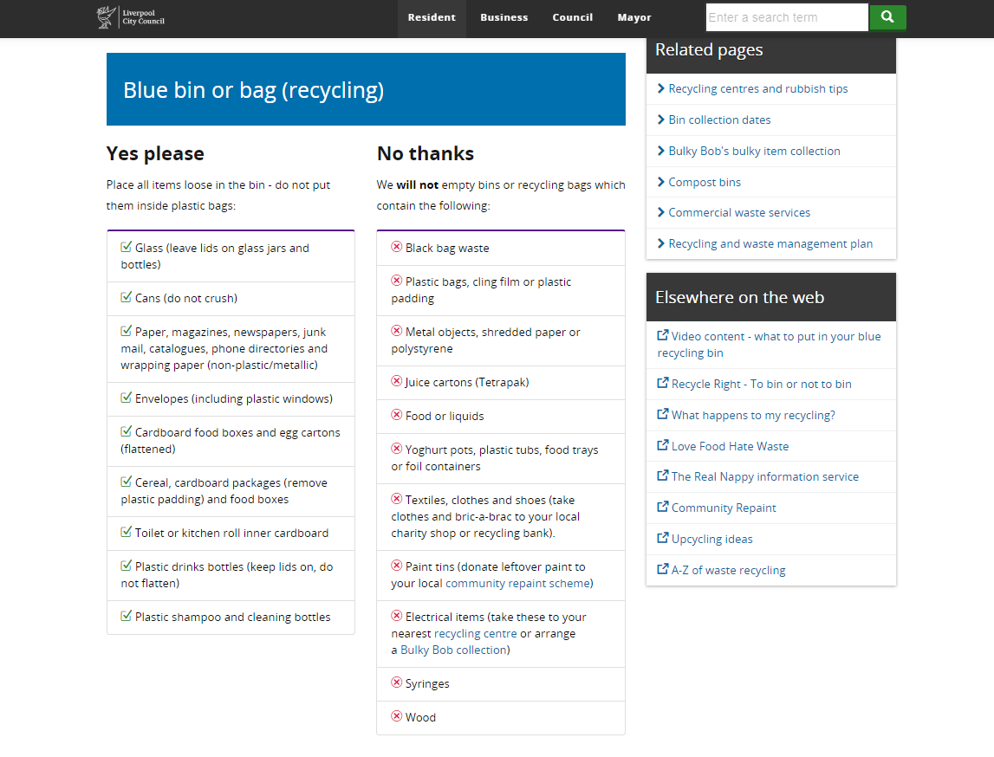
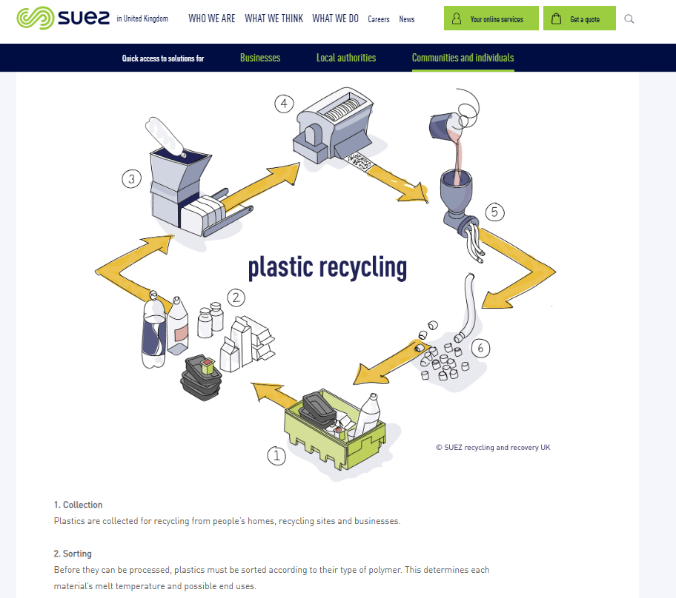
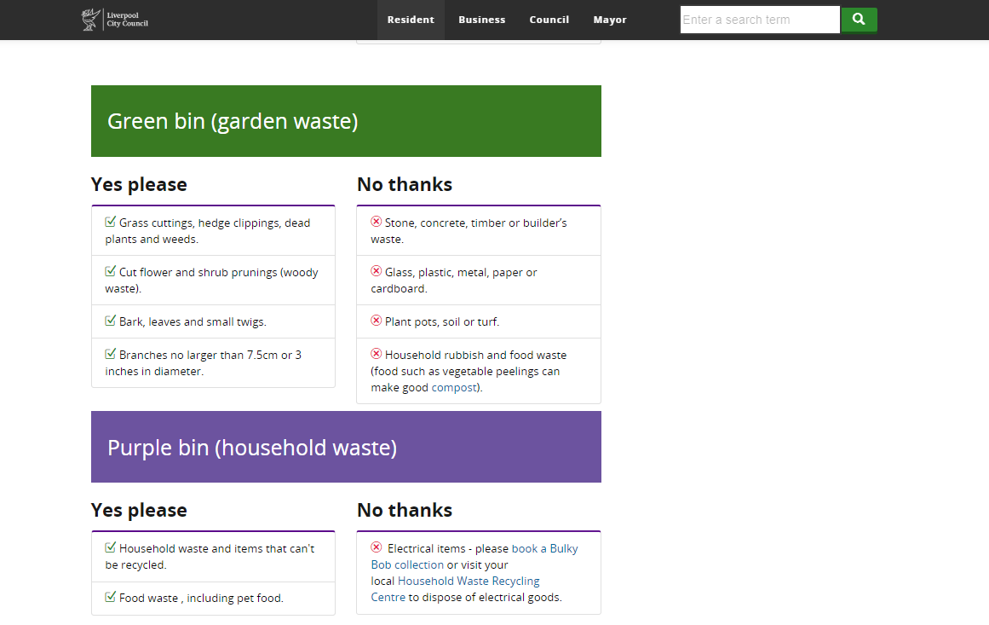
Recycling strategies of plastic in Liverpool

Slide 8
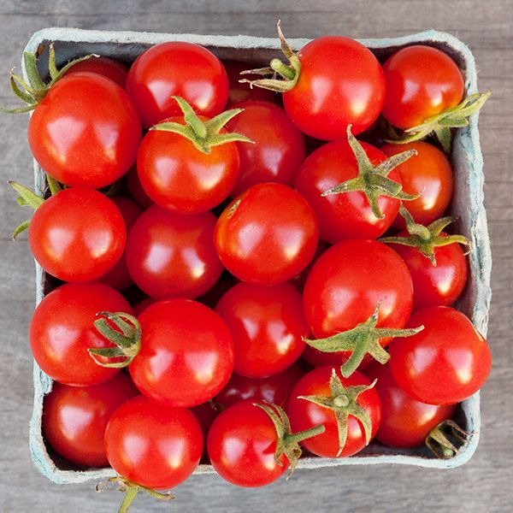
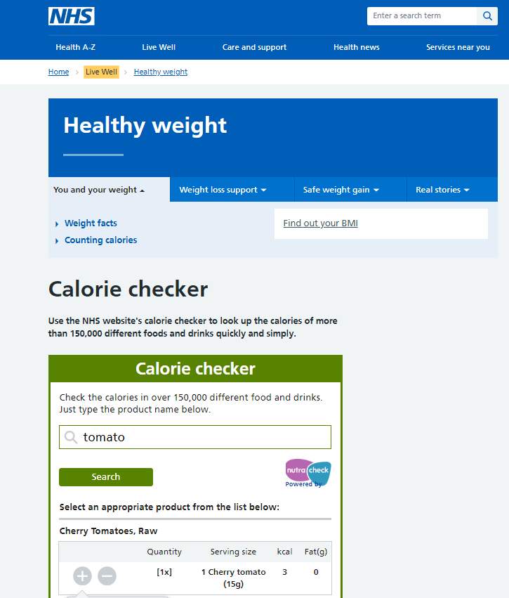
Aware of plastic or CALORIES!?
Cherry tomatoes and corresponding calories in NHS
VIBGYOR

Slide 9
iolite ndigo lue reen ellow range ed
V I B G Y O R

Slide 10
Local Government
GRAM BOOK application
based
VIBGYOR
Groups (Enterprise edition)
Children Education
SAY HI TO PLASTIC
Subscription users
Processor

Slide 11
Day in correlation to plastic
Types of Plastic
Awareness of plastic
Say Hi to Plastic
Mon
Tue
Wed
Thu
Fri
VIBGYOR
Sat
Sun

Slide 12
VIBGYOR
Gram book
Users can update the plastic usage score in Facebook and or Instagram
(Daily score or weekly usage score and or monthly usage score )
Subscription users
Users will segregate the plastic
A the team of VIBGYOR will collect the segregated waste and sent to recycling in Accordance with the plastic recycling norms -will pay the money back to the subscribed users.
Local Government
To arrange, the different type of plastic disposal bins in selected areas, so that the users can classify the plastic using the free subscription VIBGYOR app and dispose of their plastic waste in suitable bins.
Groups (Enterprise edition)
Users in any institution and or offices can register to form into groups and segregation of daily usage
Children Education
Today's children are tomorrows citizens: educating children in applying the VIBGYOR technology in daily usage
Processor
Customer usage plastic data will be stored in the database in application to the knowledge of the most usable type of plastic that is more common in that particular region and or locality and in further recommendations to those specified companies in choosing any alternative packaging application in more eco-friendly nature.

Slide 13
Timeline & Cost
Design of VIBGYOR (25 Work hours)
Recruiting Students as part-time
1st Month
Design of VIBGYOR GRAM BOOK (30 Work hours)
Recruiting the web designer app developers
2nd Month
University Integration (20 Work hours)
Design and Implementation in University offices and residential halls
3rd Month
4th - 6th Month
Feedback and Development

Slide 14
Marketing and Team construction for VIBGYOR and Approach to Local government
Feedback and development.
7th to 18th Month
Launch
For 18 months in total requirement: (2.5+7.5+5+25+50+120)* £100 = £21,000
Income generation: After 18months: minimum of (Total cost /subscribers)
Gram Book : Marketing strategy
Stage 1
Stage 2
Stage 3
14

Slide 15
Potential risks
Design of a mobile application with artistic nature in considering the adaptability of the app in frequency with the International outlook
Involvement of subscribers in updating and segregation of plastic
Strict computer algorithms in classifications of plastic (applicable to any mobile camera)
Managing a standard number of subscribers to compensate for the costs associated with the design and sustainability of the VIBGYOR
Team formation and efficient working procedures in making contact with subscribers on a regular basis; at customer available time (in the collection of segregated waste from the customer)
Managing segregated waste with the norms and or rules of land of operation
Legal issues in particular to the social networking updates
Approval from the local government authorities
Children using mobile applications
Sustainable business
Plastic-free (potential risk for the VIBGYOR but the aim for this risk to happen)
VIBGYOR

Slide 16
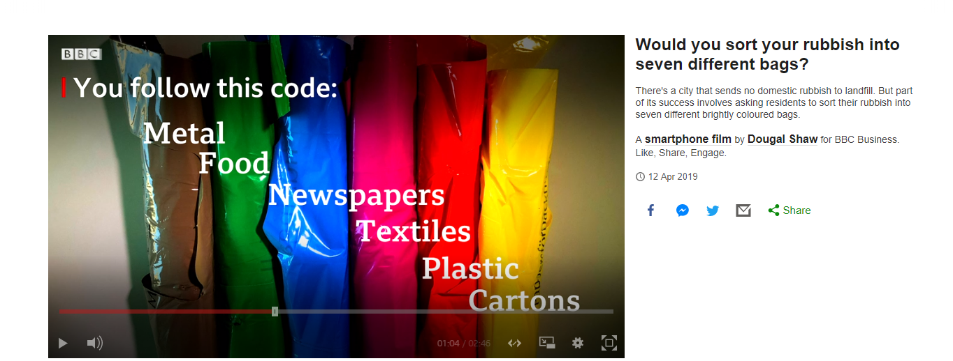
Implementation of similar kind of idea in
a city in Europe- Sweden (Eskilstuna )
On house Hold waste

Slide 17
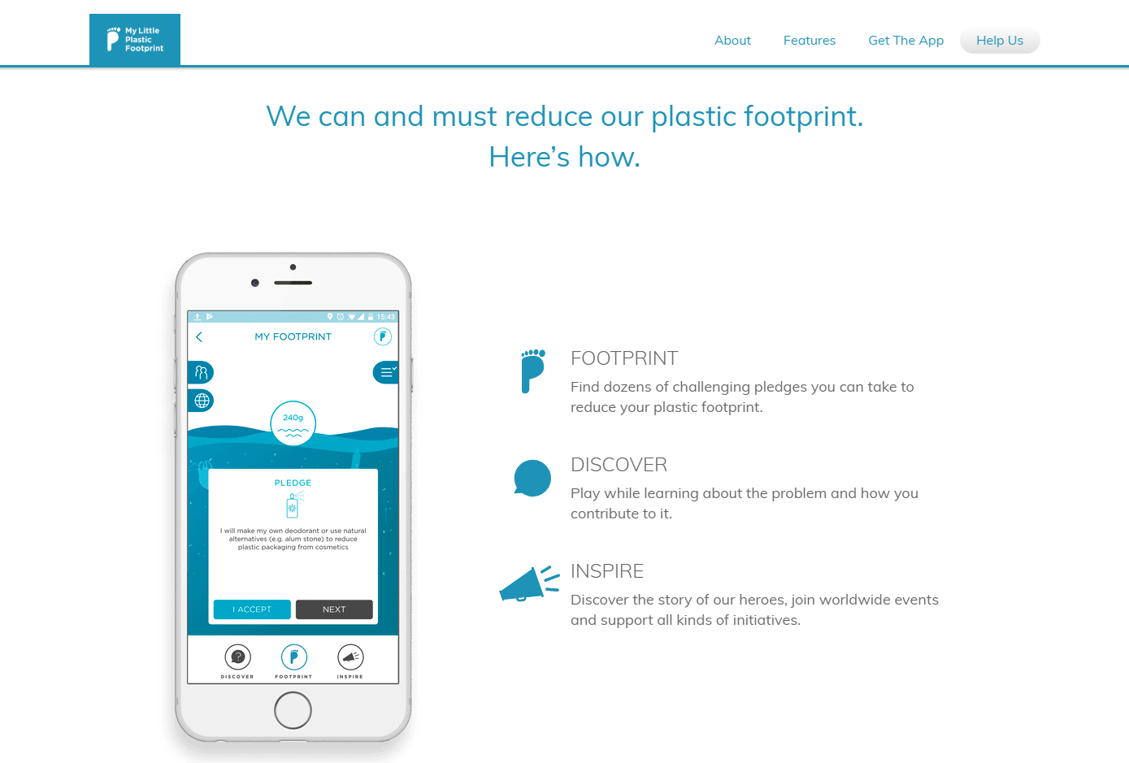
VIBGYOR
Plastic Foot print app: More about pledges
is about inclusiveness of plastic by saying HI
VIBGYOR

Slide 18
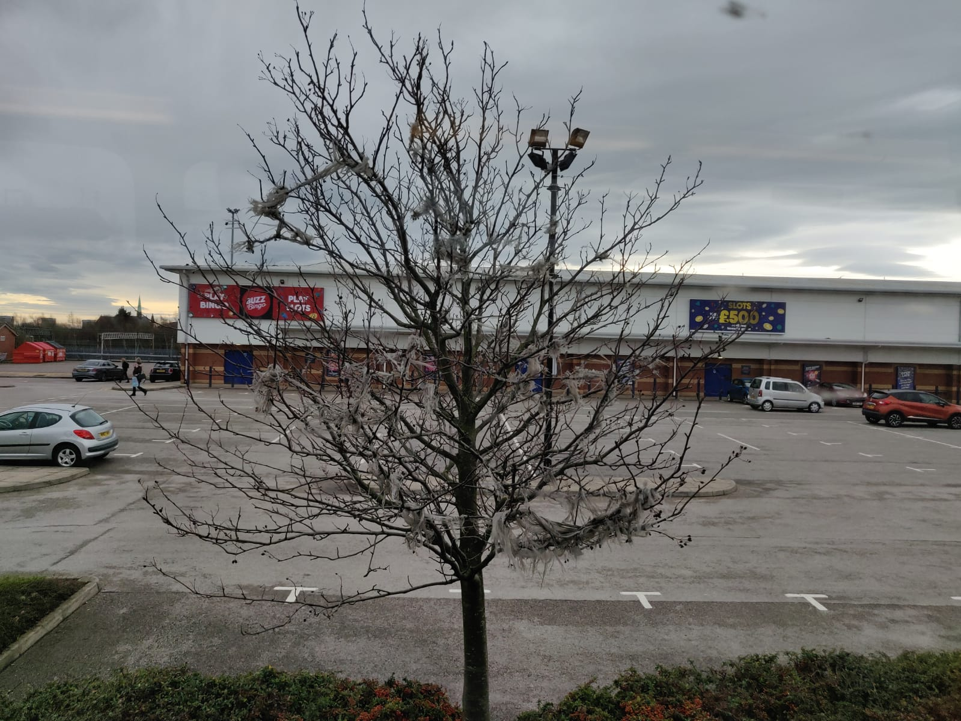
Thank you very much for listening
VIBGYOR
Looking forward for greener leaves

Slide 19
VIBGYOR

Slide 20
VIBGYOR Interface
Take A Close Look
Subscriber _Pickup call
To call to VIBGYOR team: say hello to the team
Calendar
Usage of plastic
Gram book
Share the usage of daily plastic in grams on to Instagram or Facebook or twitter
Processor
Usage will be downloaded to server of VIBGYOR for processing data base and will update to the customer about the probable recycling of grams of plastic disposed

Slide 21

VIBGYOR Gram book Interface
Say Hi to plastic
80%
70%
60%
40%

Slide 22

VIBGYOR
PHONE SETTING
STATISTICS
CAMERA
CALENDER
Recyclable plastic location
VIBGYOR SMART Interface (Sorting)
CONTACTS

